Slide 1
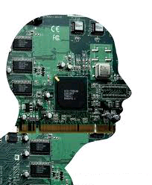
Artificial intelligence
Introduction to Artificial Intelligence
BOOK : Artificial Intelligence A Modern Approach
Stuart J. Russell and Peter Norvig
By: Teame M.

Slide 2

Chapter one
Introduction to AI

Slide 3
Introduction to Artificial Intelligence
Goals of this Course
AI is a very broad field with many subareas
Make machines smarter (primary goal)
Understand what intelligence is (Nobel Laureate purpose)
Make machines more useful (entrepreneurial purpose)
Probabilistic Learning, and Machine Learning
Notes:
3

Slide 4
Introduction to Artificial Intelligence
Artificial Intelligence
Definition AI
Objectives /Goals of AI
Approaches to AI and Hypothesis of AI
The Foundations of AI : Bits of History and the State of the Art
Application Areas of AI
Notes:
4

Slide 5
Introduction to Artificial Intelligence
Artificial Intelligence
Artificial Intelligence made of:
Artificial:
Produced by human art or effort,
Not originating naturally.
Intelligence:
Thinking capability
Notes:
5

Slide 6
Introduction to Artificial Intelligence
Artificial Intelligence
What is Intelligence?
Intelligence:
The capacity to learn and solve problems (Websters dictionary)
In particular,
The ability to solve novel problems
The ability to act rationally
The ability to act like humans
the computational part of the ability to achieve goals in the world. Varying kinds and degrees of intelligence occur in people, many animals and some machines.
Notes:
6

Slide 7
Introduction to Artificial Intelligence
WHAT’S INVOLVED IN INTELLIGENCE?
Ability to interact with the real world
to perceive, understand, and act
e.g., speech recognition and understanding and synthesis e.g., image understanding
Reasoning and Planning
modeling the external world, given input
solving new problems, planning, and making decisions
Learning and Adaptation
we are continuously learning and adapting
our internal models are always being “updated” e.g., a baby learning to categorize and recognize animals
Notes:
7

Slide 8
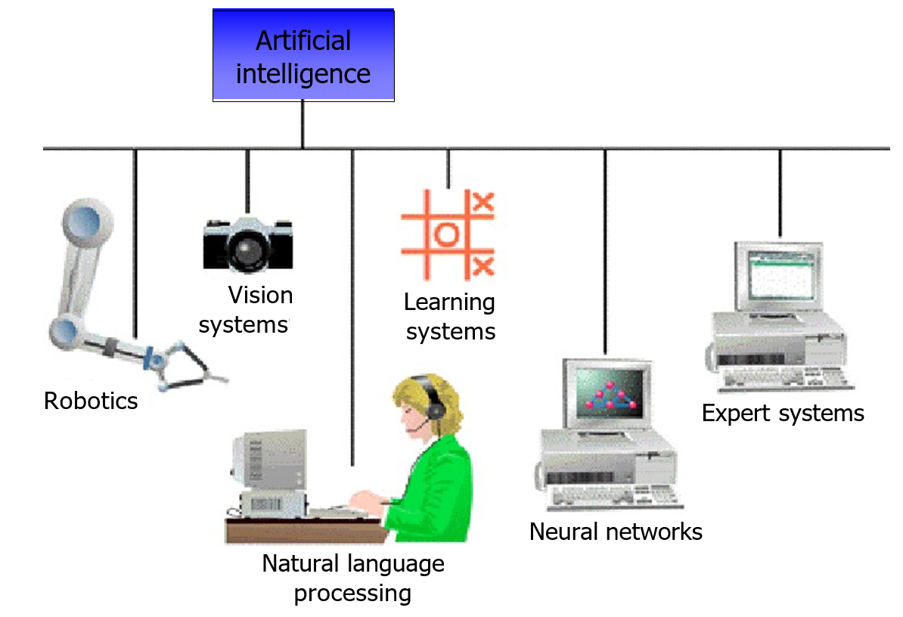
Introduction to Artificial Intelligence
Notes:
8

Slide 9
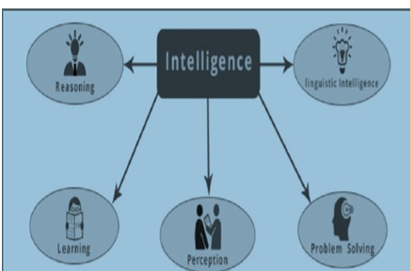
Introduction to Artificial Intelligence
Artificial Intelligence
Intelligence is composed of
Reasoning
Learning
Problem Solving
Perception
Linguistic Intelligence
Notes:
9

Slide 10
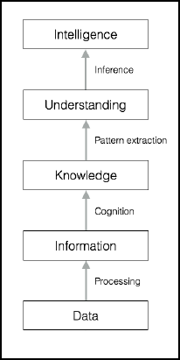
Introduction to Artificial Intelligence
Cont…
Let's see how raw data gets converted to intelligence through various levels of processing:
Notes:
10

Slide 11
Introduction to Artificial Intelligence
What involved in Intelligence (again)
Intelligent behavior/characteristics
Learn from experience
Apply knowledge acquired from experience
Handle complex situations
Solve problems when important information is missing
Determine what is important
React quickly and correctly to a new situation
Understand visual images
Process and manipulate symbols
Be creative and imaginative
Use heuristics
Notes:
11

Slide 12
Introduction to Artificial Intelligence
Objectives of AI
In general, the specific goals of AI are:
Make machines smarter (primary goal)
Understand what intelligence is
Make machines more useful
Notes:
12

Slide 13
Introduction to Artificial Intelligence
Approaches of AI
Approaches to AI do mean making computer:
Think like a human (Thinking humanly): The cognitive modelling approach
Act like a human (Acting humanly): The Turing Test approach
Think rationally (Thinking rationally): The "laws of thought" approach
Act rationally (Acting rationally): The rational agent approach
Notes:
13

Slide 14
Introduction to Artificial Intelligence
Think Humanly
If we are going to say that a given program thinks like a human, we must have some way of determining how humans think: the actual workings of human minds.
There are two ways to do this:
through introspection trying to catch our own thoughts as they go by-and
Through psychological experiments. Through cognitive science
This approach Requires scientific theories of internal activities of the brain.
Notes:
14

Slide 15
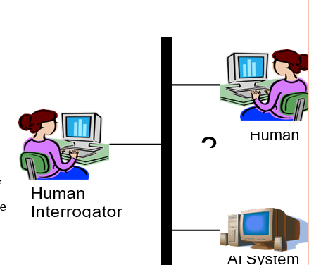
Introduction to Artificial Intelligence
Acting Humanly: Turing Test
In general, the specific goals of AI are:
Use operational qualification rather than listing intelligence qualification
The Turing Test (1950): "Computing machinery and intelligence“ for testing intelligence of machine.
This test is proposed by Alan Turing
He proposed computer pass that tests if a human interrogator, after posing some written questions, cannot tell whether the written responses come from a person or not Programming.
Notes:
15

Slide 16
Introduction to Artificial Intelligence
Cont..
Turing Test suggests major components required for AI
knowledge representation to store what it knows.
Automated reasoning :use the stored information to answer questions and to draw new conclusions;
computer vision: to perceive objects
machine learning: adapt to new circumstances and to detect and extrapolate patterns.
Natural language processing : to communicate successfully in NL
Robotics to manipulate objects and move about. 14
* Question: is it important that an intelligent system act like a human?
Notes:
16

Slide 17
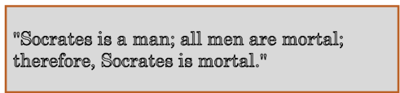
Introduction to Artificial Intelligence
THINKING RATIONALLY
Idea is from Aristotle philosophy of “right thinking," that is, irrefutable reasoning processes
His syllogisms provided patterns for argument structures that always yielded correct conclusions when given correct premises-
for example,
These laws of thought were supposed to govern the operation of the mind; their study initiated the field called logic.
Notes:
17

Slide 18
Introduction to Artificial Intelligence
ACTING RATIONALLY :RATIONAL AGENT APPROACH
An agent (the Latin word to mean ager to do) is just something that acts something.
A rational agent is one that acts so as to achieve the best outcome or, when there is uncertainty, the best expected outcome.
Making correct inferences is sometimes part of being a rational agent,
All the skills needed for the Turing Test are there to allow rational actions.
Rational behavior
Doing the right thing
What is the “right thing”
That which is expected to maximize goal achievement,
given available information
We do many (“right”) things without thinking
Notes:
18

Slide 19
Introduction to Artificial Intelligence
THE FOUNDATIONS OF AI
Philosophy: Logic, methods of reasoning, mind as physical system, foundations of learning, language, rationality.
Mathematics: Formal representation and proof, algorithms, computation,
(un)decidability, (in)tractability
Neuroscience: neurons as information processing units.
Psychology/ : how do people behave, perceive, process cognitive
Cognitive Science information, represent knowledge.
Computer: building fast computers engineering
Linguistics: knowledge representation, grammars
Probability/Statistics: modeling uncertainty, learning from data
Economics: utility, decision theory, rational economic agents
Computer Engineering: building fast computers
Notes:
19

Slide 20
Introduction to Artificial Intelligence
History of AI
1943: early beginnings
McCulloch & Pitts: Boolean circuit model of brain/ Invented Artificial neurons
1950: Alan Turing
Turing's "Computing Machinery and Intelligence“ was invented
1956: birth of AI
Dartmouth Conference: "Artificial Intelligence“ name adopted
1965: Robinson's complete algorithm for logical reasoning
1969-79: Early development of knowledge based systems took place
1980-- AI becomes an industry
1986-- Neural networks return to popularity
1987-- AI becomes a science
1995-- The emergence of intelligent agents
Currently: robotics, drones, self-driving cars etc..
Notes:
20

Slide 21
Introduction to Artificial Intelligence
Applications of AI
AI has been applied in different areas. Such as:
Expert System(ES)
Natural Language Processing(NLP)
Speech(Voice) understanding
Robotics and sensory
Computer vision and scene recognition
Intelligent Computer aided instructions
Neural Computing
Game Playing
Languages Translation
Fuzzy logic
Genetic Algorithms 19
Intelligent Agents
Notes:
21

Slide 22
Introduction to Artificial Intelligence
Home/Dorm Work
Can Computers Talk?
Can Computers Recognize Speech?
Can Computers Understand speech?
Can Computers Learn and Adapt ?
Can Computers “see”?
Can computers plan and make optimal decisions?
Notes:
22

Slide 23
Introduction to Artificial Intelligence
Can Computers Talk?
This is known as “speech synthesis”
translate text to phonetic form
e.g., “fictitious” -> fik-tish-es
use pronunciation rules to map phonemes to actual sound
e.g., “tish” -> sequence of basic audio sounds
Conclusion:
– NO, for complete sentences
– YES, for individual word
Notes:
23

Slide 24
Introduction to Artificial Intelligence
Can Computers Recognize Speech?
Speech Recognition:
mapping sounds from a microphone into a list of words
classic problem in AI, very difficult
“Lets talk about how to wreck a nice beach”
(I really said “ ”)
Recognizing single words from a small vocabulary
systems can do this with high accuracy (order of 99%)
e.g., directory inquiries
limited vocabulary (area codes, city names)
computer tries to recognize you first, if unsuccessful hands you over to a human operator
saves millions of dollars a year for the phone companies
Notes:
24

Slide 25
Introduction to Artificial Intelligence
Recognizing human speech
Recognizing normal speech is much more difficult
speech is continuous: where are the boundaries between words?
e.g., “John’s car has a flat tire”
large vocabularies
can be many thousands of possible words
we can use context to help figure out what someone said
e.g., hypothesize and test
try telling a waiter in a restaurant:
“I would like some dream and sugar in my coffee”
background noise, other speakers, accents, colds, etc
on normal speech, modern systems are only about 60-70% accurate
Notes:
25

Slide 26
Introduction to Artificial Intelligence
Can Computers Understand speech?
Understanding is different to recognition:
“Time flies like an arrow”
assume the computer can recognize all the words
how many different interpretations are there?
1. time passes quickly like an arrow?
2. command: time the flies the way an arrow times the flies
3. command: only time those flies which are like an arrow
4. “time-flies” are fond of arrows
only 1. makes any sense,
but how could a computer figure this out?
clearly humans use a lot of implicit commonsense knowledge in communication
Conclusion: NO, much of what we say is beyond the capabilities of a computer to understand at present.
Notes:
26

Slide 27
Introduction to Artificial Intelligence
Can Computers Learn and Adapt ?
Learning and Adaptation
consider a computer learning to drive on the free way
we could teach it lots of rules about what to do
or we could let it drive and steer it back on course when it heads for the embankment
systems like this are under development (e.g., Daimler Benz) e.g., RALPH at CMU
– in mid 90’s it drove 98% of the way from Pittsburgh to San Diego without any human assistance
machine learning allows computers to learn to do things without explicit programming.
many successful applications:
requires some “set-up”: does not mean your PC can learn to forecast the stock market or become a brain surgeon
Conclusion: YES, computers can learn and adapt, when presented with information in the appropriate way
Notes:
27

Slide 28

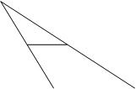

Introduction to Artificial Intelligence
Can Computers “see”?
Recognition v. Understanding (like Speech)
Recognition and Understanding of Objects in a scene
look around this room
you can effortlessly recognize objects
human brain can map 2d visual image to 3d “map”
Why is visual recognition a hard problem?
Conclusion:
mostly NO: computers can only “see” certain types of objects under limited circumstances
YES, for certain constrained problems (e.g., face recognition)
Notes:
28

Slide 29
Introduction to Artificial Intelligence
Can computers plan and make optimal decisions?
Intelligence
involves solving problems and making decisions and plans
e.g., you want to take a holiday in Ethiopia
you need to decide on dates, flights
you need to get to the airport, etc
involves a sequence of decisions, plans, and actions
What makes planning hard?
the world is not predictable:
your flight is canceled or there’s a backup
there are a potentially huge number of details
do you consider all flights? all dates?
– no: commonsense constrains your solutions
AI systems are only successful in constrained planning problems
Conclusion: NO, real-world planning and decision-making is still beyond the capabilities of modern computers
exception: very well-defined, constrained problems
Notes:
29

Slide 30

Introduction to Artificial Intelligence
Notes:
30

